Slide 1
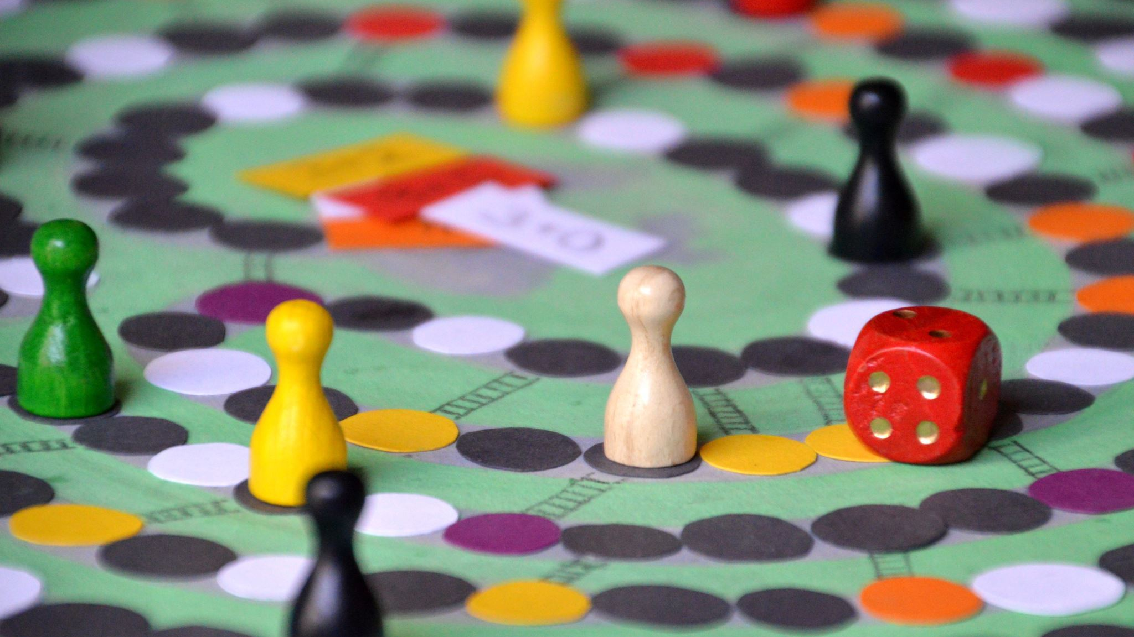
Game Hub
Kambarova Fariza and Bayalieva Zhyldyz

Slide 2

What is GameHub?
GameHub is a cutting-edge gaming website that aims to provide a comprehensive and immersive gaming experience to enthusiasts worldwide. With a vast collection of games, GameHub is designed to be a one-stop destination for all gaming enthusiasts. Our website offers a user-friendly interface, advanced features, and a wide range of genres, ensuring that users can easily discover, play, and enjoy their favorite games.

Slide 3
Our team members:
Kambarova Fariza
with his expertise in front-end development, took the lead in designing the user interface, implementing smooth interactions, and optimizing the website's performance.
Bayalieva Zhyldyz
with his strong back-end development skills, worked on JavaScript, Bootstrap, Html and CSS ensuring secure and efficient data handling.

Slide 4

What are the key features of our Website?

Slide 5

Exceptional Website Design:
At GameHub, we understand that user experience is paramount. Therefore, we have dedicated significant effort to create a visually appealing and user-friendly website design. Our interface is thoughtfully crafted, featuring an intuitive layout that allows for easy navigation and seamless browsing. The design elements are carefully chosen to complement the gaming aesthetics, with visually striking graphics and animations that enhance the overall experience. We have also optimized the website for different screen sizes, ensuring a seamless and immersive gaming experience across devices, including desktops, laptops, tablets, and smartphones.

Slide 6
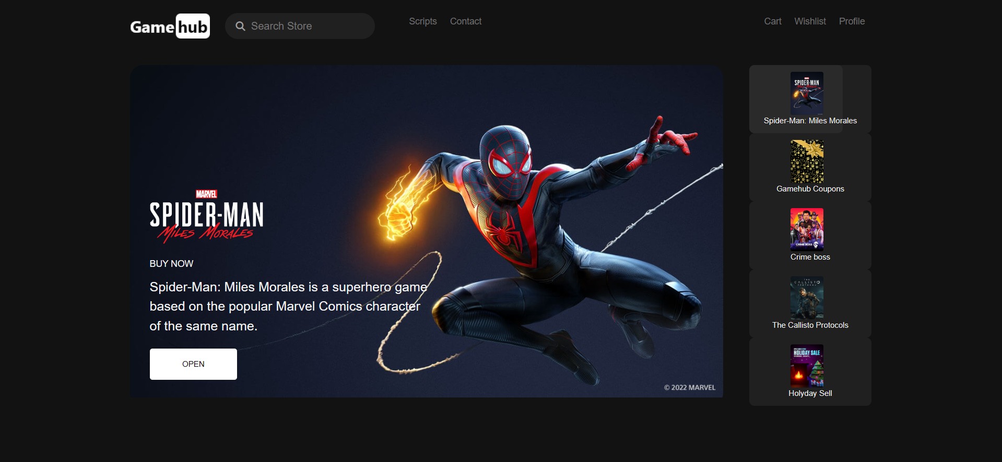
Our Gallery

Slide 7


Thank you for your attention

